Slide 1
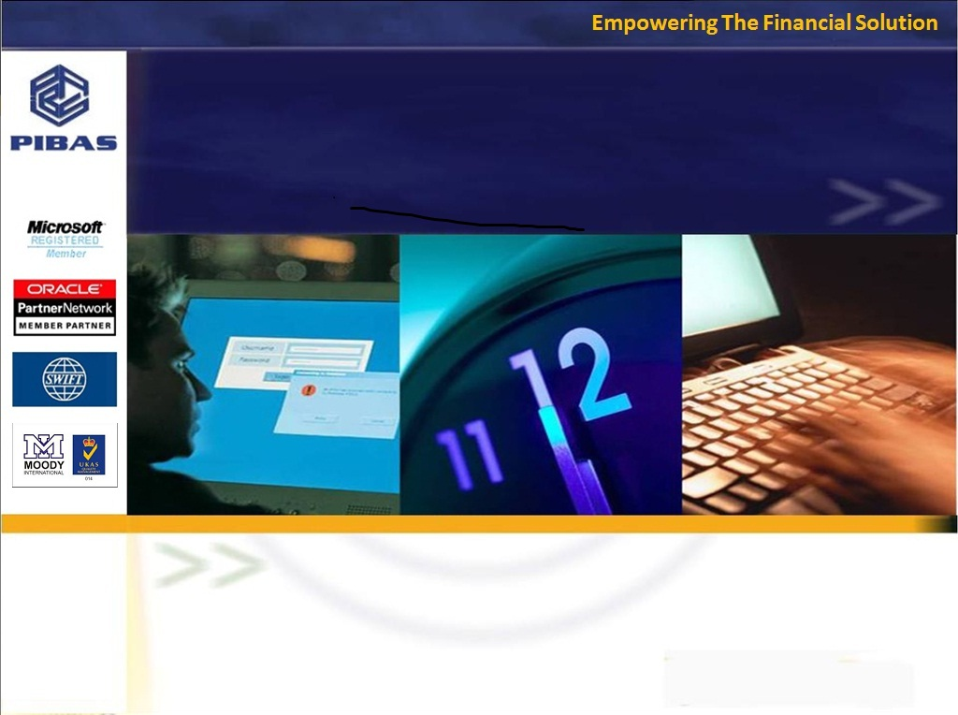
Product Knowledge Training Session PIBAS Products – Account Opening Part 4
Presented By Muhammad Asim Senior Support Analyst

Slide 2
Contents
Customer Account Opening Part 4
Account Level Limit
Miscellaneous Linkages
Limit Utilization Inquiry
Maintenance Report
Limit Expired / About to Expire Report
Limit Utilization / Exception Report
Group Balance List

Slide 3
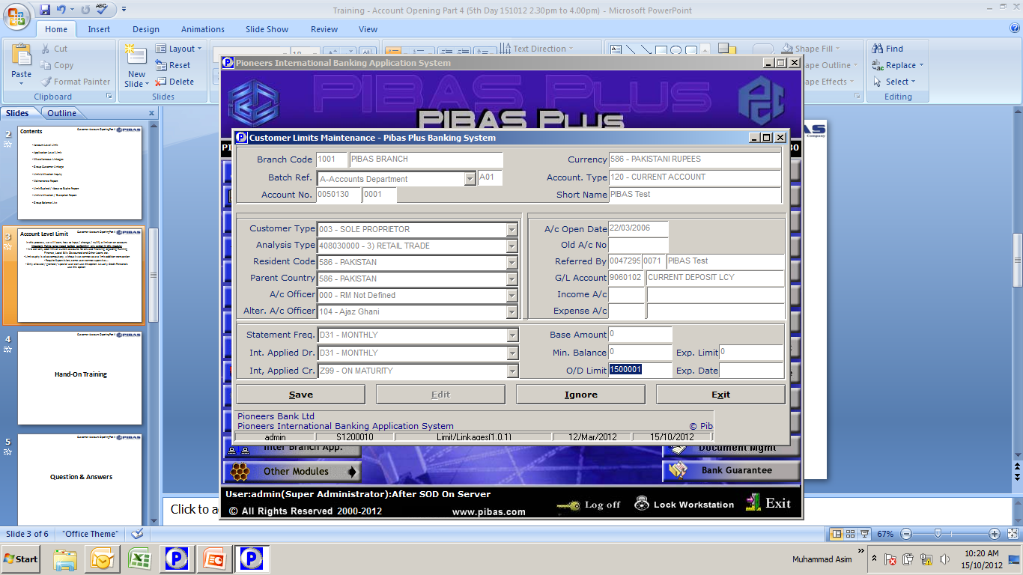
Account Level Limit
Customer Account Opening Part 4
In this process, we will learn, how to input / change / nullify a limit on an account. Important Points to be noted before performing any action in this module:
We can only add limit on current accounts for onward financing regarding Running Finance, Local Bills Discounted and Other Loans etc.
Limit expiry is also compulsory, without it we cannot save a limit addition transaction
Require Supervision; same user cannot supervise….
Only allowed / granted / special user can use this option. Usually Credit Personals use this option

Slide 4
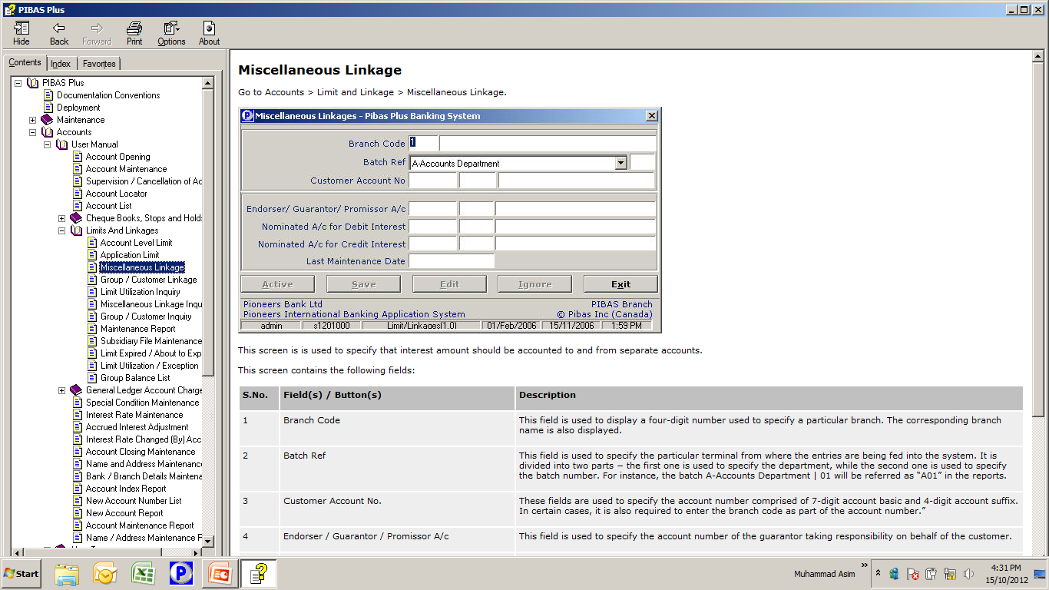
Misc. Linkage
Customer Account Opening Part 4
In this process, we will learn, how to link / nominate an account for Debit or Credit Mark-up . Important Points to be noted before performing any action in this module:
Incase of Deposit Account, Credit Account will be linked for its periodical profit payment (if required)
Incase of Loan Account, Debit Account will be linked for its periodical markup recovery (if required)
In case of Debit Markup linkage account, usually another account will be opened under category Markup on __________ Account. (this condition may vary from bank to bank)

Slide 5
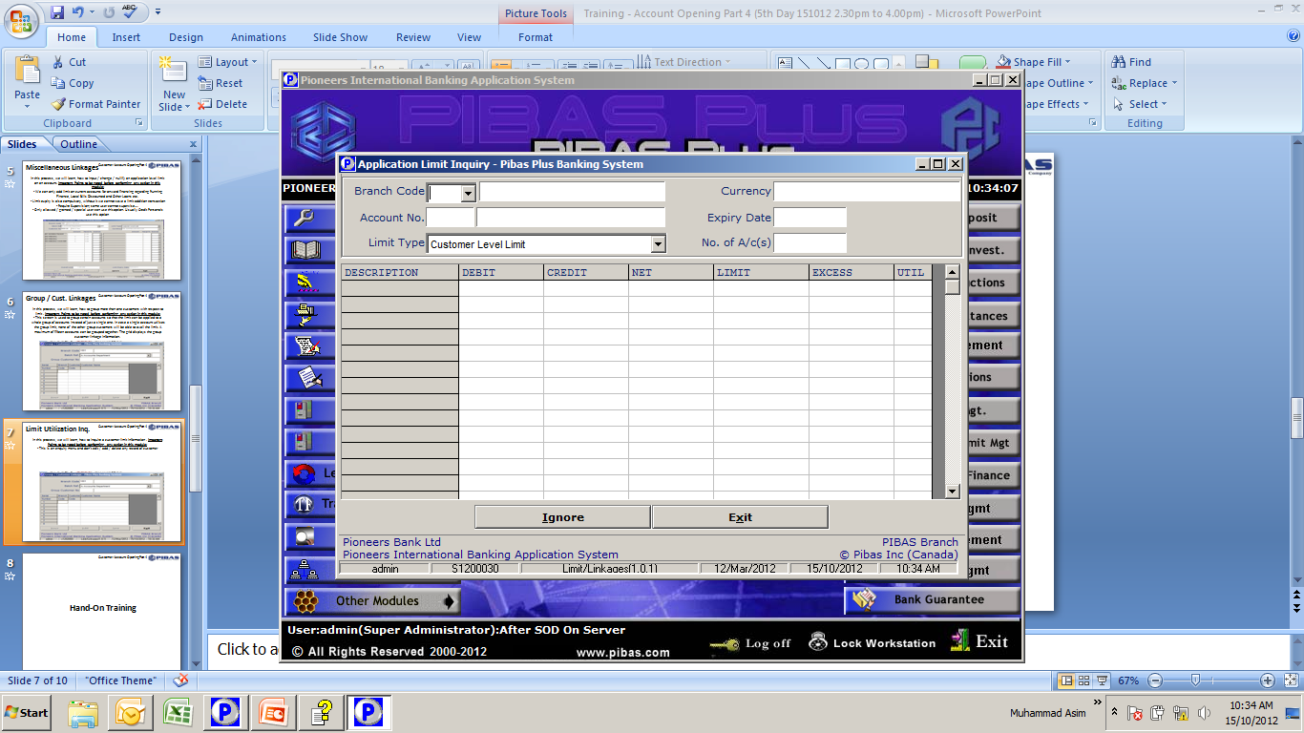
Limit Utilization Inq.
Customer Account Opening Part 4
In this process, we will learn, how to inquire a customer limit information . Important Points to be noted before performing any action in this module:
This is an enquiry menu and we cannot edit / add / delete any record of customer from this menu
This option provides us many important information i.e. Expiry date, No. of Customers in a Group, Total Limit, Limit Utilized and Excess over Limit (if any).

Slide 6
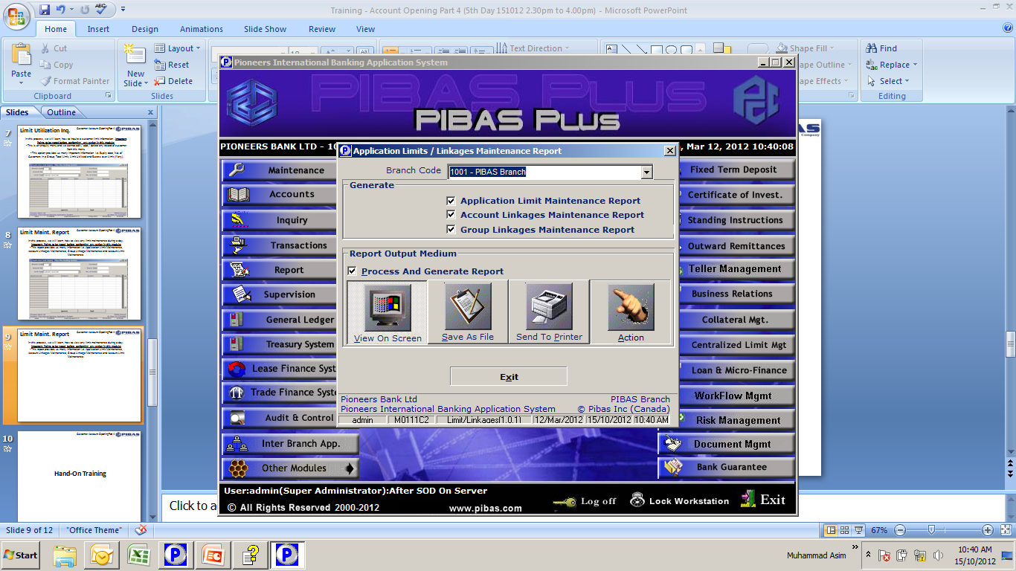
Limit Maint. Report
Customer Account Opening Part 4
In this process, we will learn, how to view any limit maintenance during a day. Important Points to be noted before performing any action in this module:
This report provides us many information i.e. Application Limit Maintenance, Account Linkages Maintenance, Group Linkage Maintenance and Account Limit Maintenance.

Slide 7
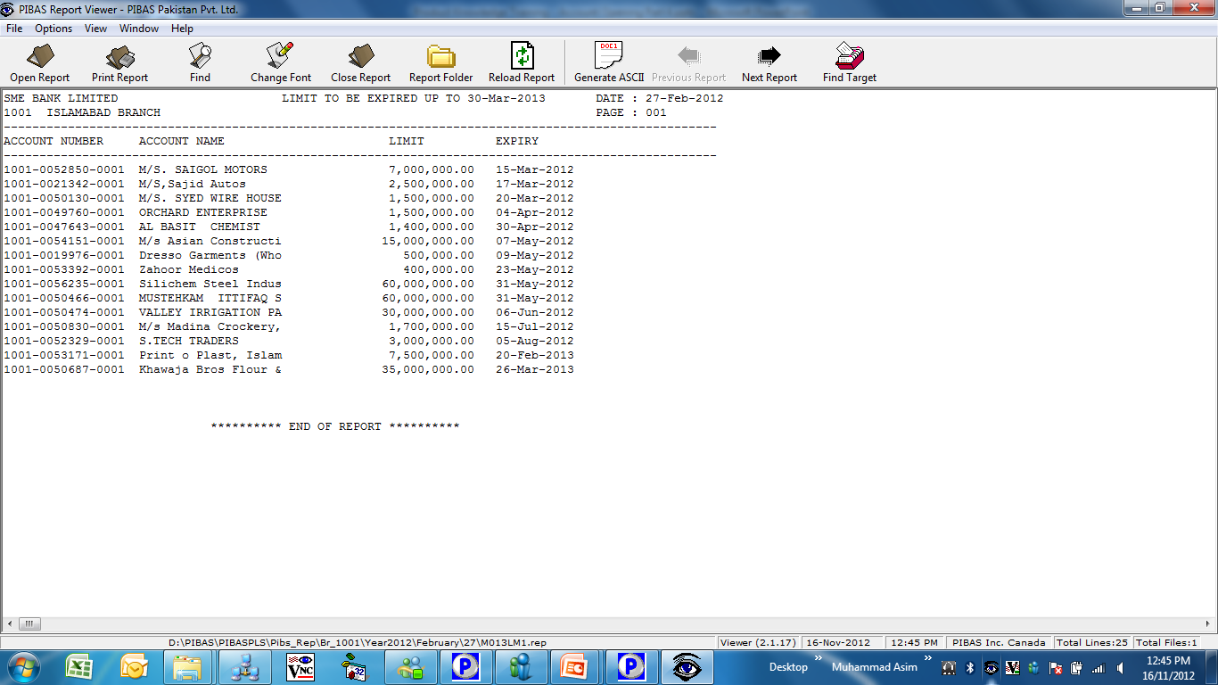
Limit Expire/About to…
Customer Account Opening Part 4
In this process, we will learn, how to view any limit (s) that have been expired or going to be expired. Important Points to be noted before performing any action in this module:
This is important report for a Credit Personal for decision making and for onward request for extension of credit limits of loan account (s) etc.

Slide 8
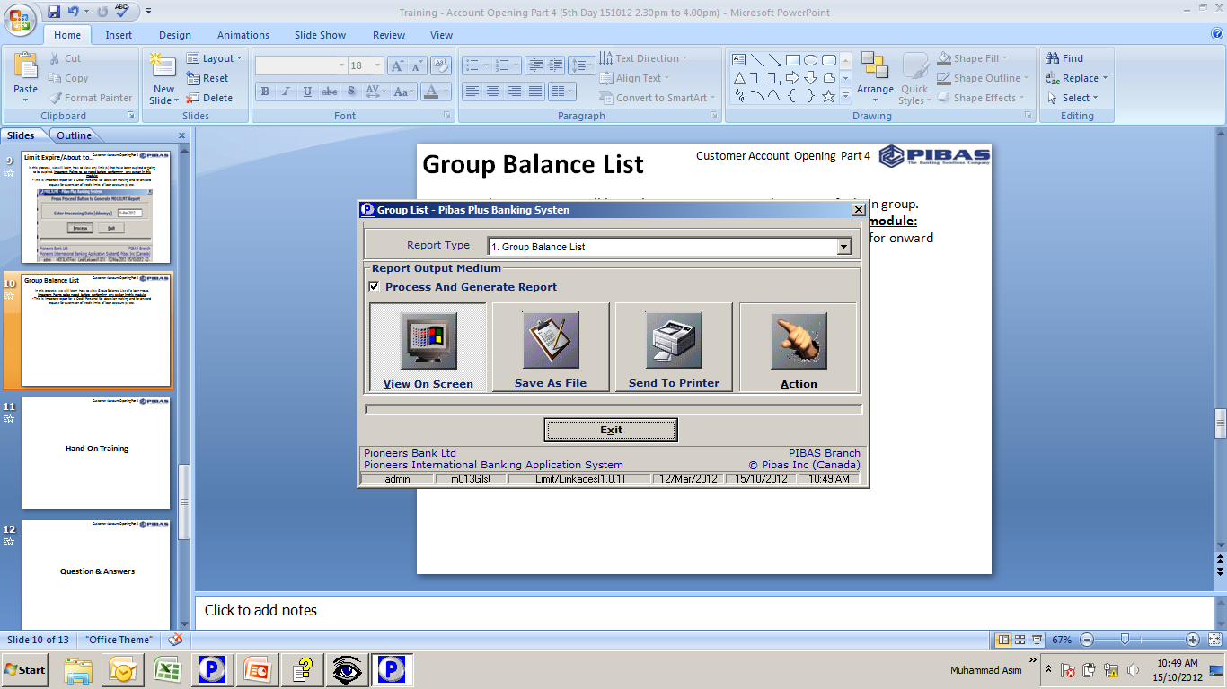
Group Balance List
Customer Account Opening Part 4
In this process, we will learn, how to view Group Balance List of a loan group. Important Points to be noted before performing any action in this module:
This is important report for a Credit Personal for decision making and for onward request for extension of credit limits of loan account (s) etc.

Slide 9
Customer Account Opening Part 4
Many thanks for your active participation

